Slide 1


Weather Forecasting Project
By: Abdulrahman Almajdalawi

Slide 2
Goal of the Project
Find the model that can most accurately predict the temperature according to a forecast in a certain location, corrected to longitude and latitude, using some ML models, while trying to find the best Hyper parameters for them.
We will mainly use MSE as the main scoring value when searching for the optimal set of hyperparameters during training of the model
The data will be split into training and testing data sets, and the training data sets will be further split into time-series-aware sets of data as validation sets to find the best hyperparameters that give the best scoring value in the cross-validation part of the pipeline.

Slide 3
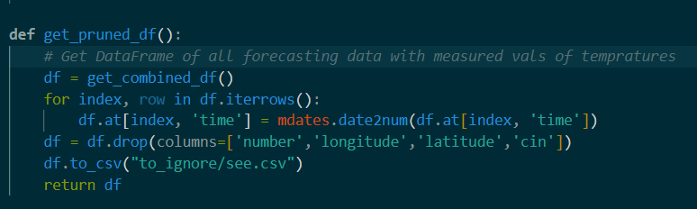
Preprocessing of the Data
The data contained in the forecast csv files of 2014 were merged and the first 50 rows of each data frame were removed.
Cascade functions in prepare_datasets.py to produce ready-to-use DataFrames.
The features/columns with irrelevant values such as latitude and longitude, number and cin (due to large amounts of null values).

Slide 4
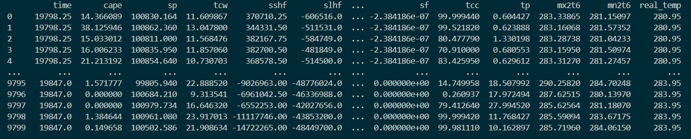
Preprocessing of the Data
Values in most columns were scaled using StandardScaler, before being input into the Cross-Validator/ML model.

Slide 5
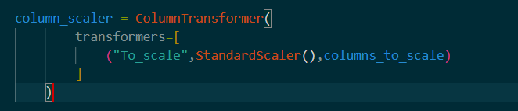
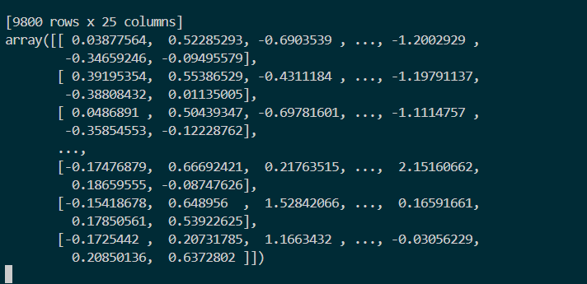
Preprocessing of the Data

Slide 6
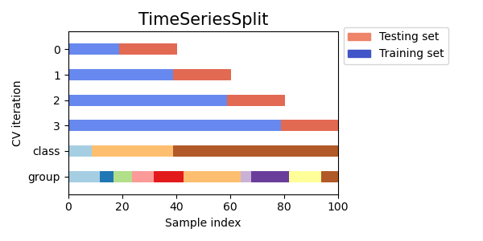
Cross-Validation and Validation Sets
Each of the three ML models where parts of a make_pipeline method and were ran inside a cross_validator class that searches the best possible fit of the model according to some scoring variable given to the constructor of the class.
The TimeSeriesSplit method was used to generate k folds of the training data subset

Slide 7

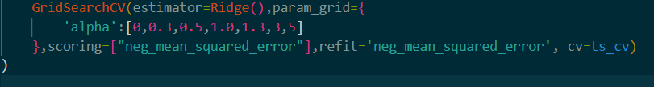
Cross-Validation and Validation Sets
The MSE was used as the scoring variable inside the cross-validation GridSearchCV class, to find the best parameters.

Slide 8
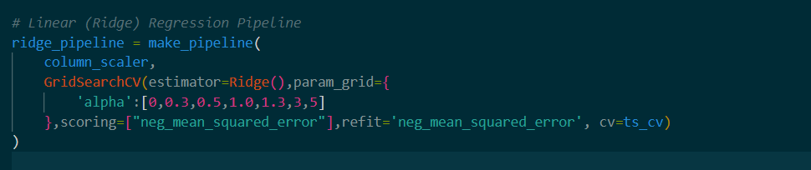
Ridge Regression
Ridge Regression was used in the first pipeline, and the value of alpha was varied across 6 values (which acts as a shrinkage parameter for the features/inputs in the dataset).
The pipeline returns the estimator with the “best” value of scoring parameter, instantiated with the optimal alpha variable.

Slide 9
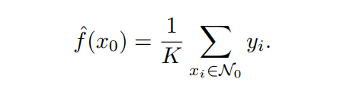
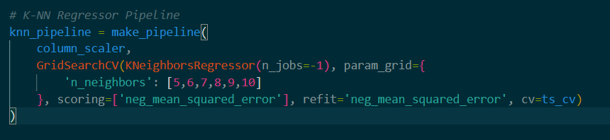
k-Nearest Neighbor Regressor
The value of k was varied inside the cross-validator, ranging between 5 and 10

Slide 10
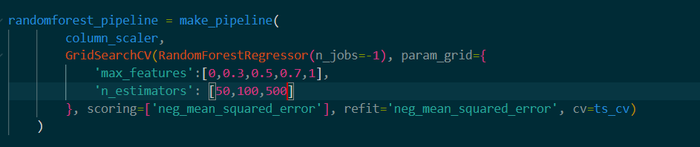
Random Forest Regressor
The sub-sample size was varied in the cross-validator, few values were chosen due to the process being extremely CPU-intensive

Slide 11
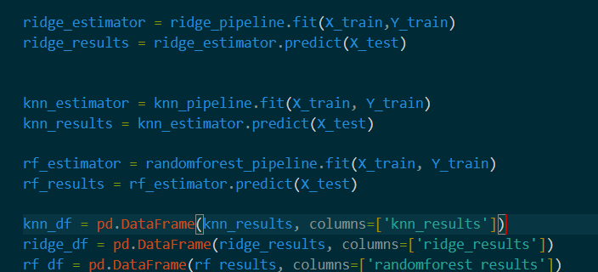
Results
The resulting optimal estimators from the cross-validation pipelines where then used to predict the temperatures on the values of the forecast for the last week of April.
The results were then compiled, and the mean was calculated according to the datetime using the groupby method on the combined Dataframe.

Slide 12
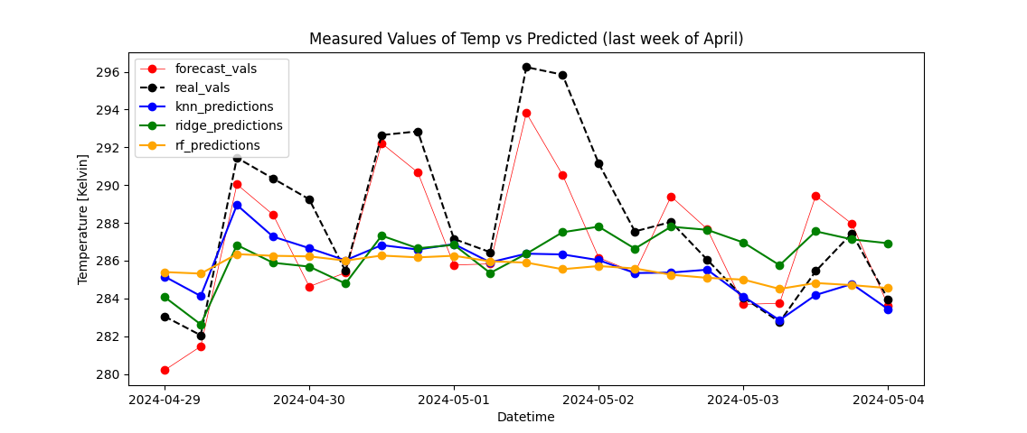
Results

